Slide 1
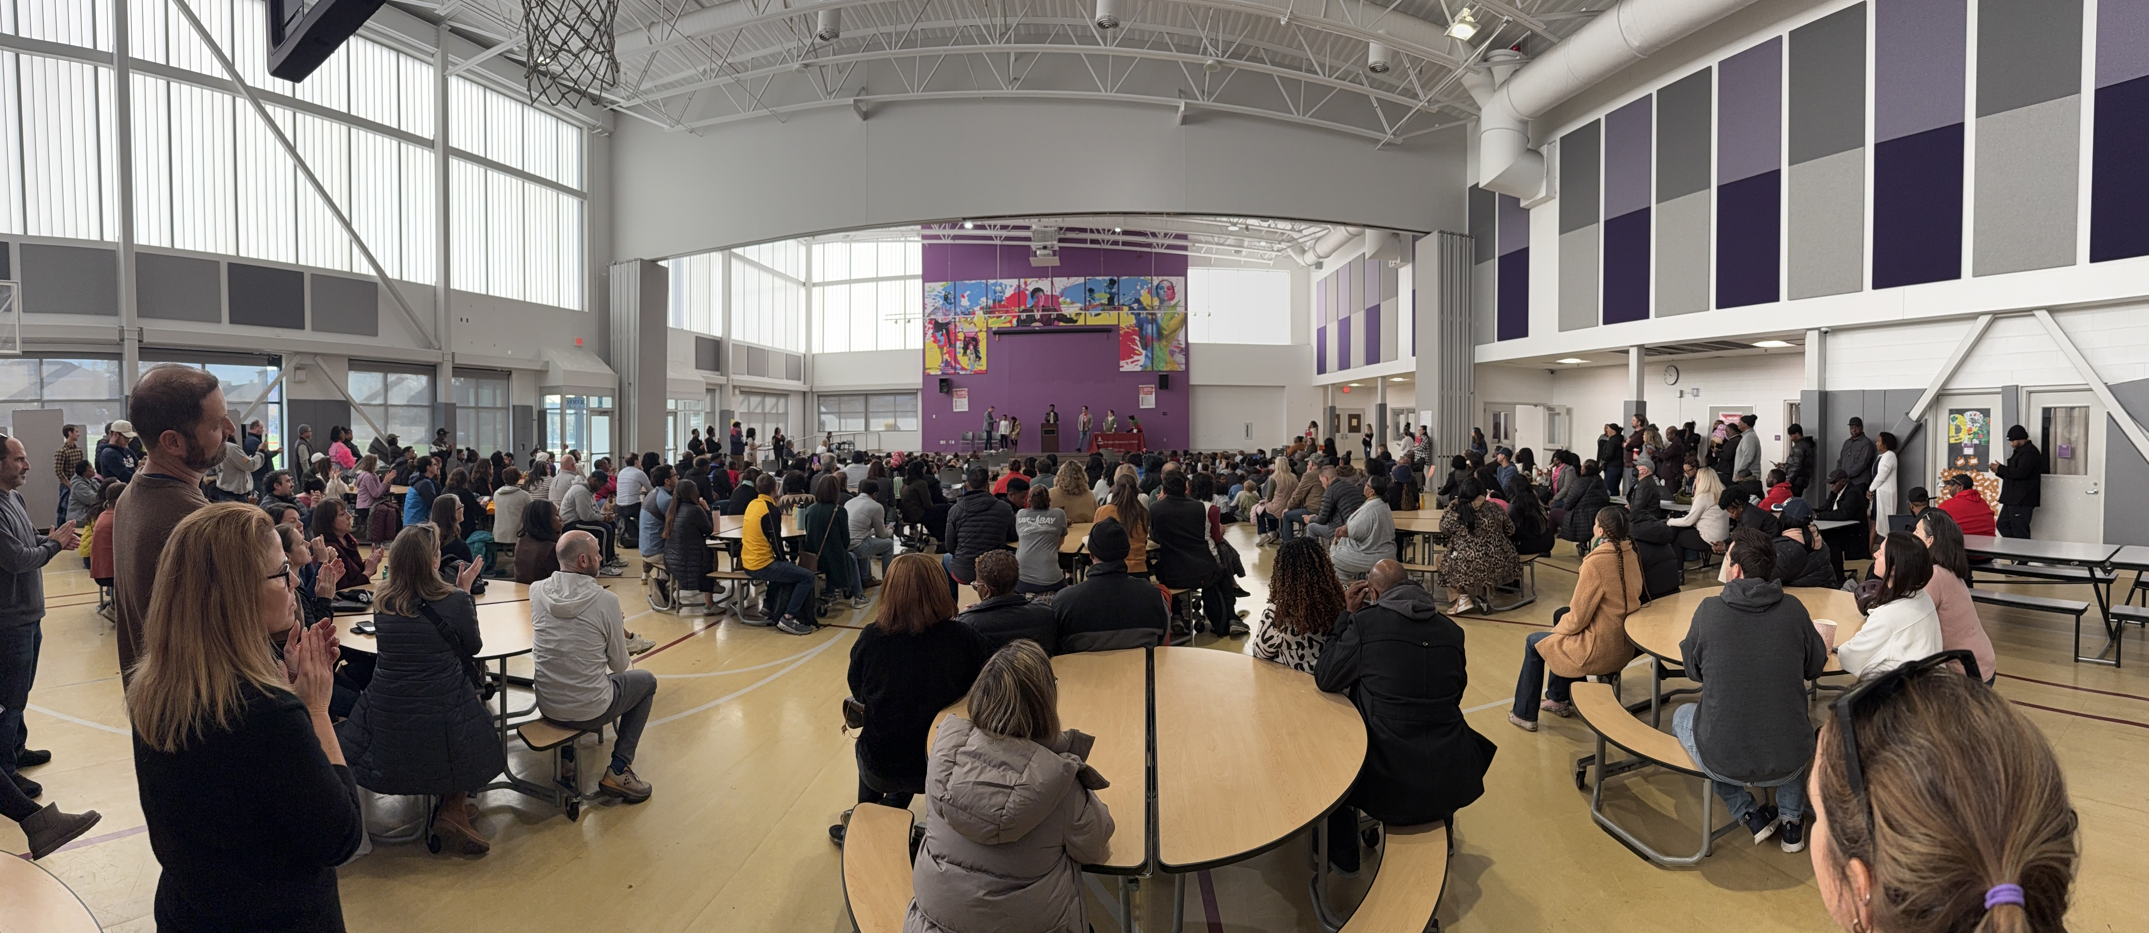
Capitol Hill Cluster School
PTA Community Meeting
September 16, 2026

Slide 2
Agenda
Meet the PTA
Cluster 40th Anniversary
Campus Updates
Budget
Renovators House Tour

Slide 3
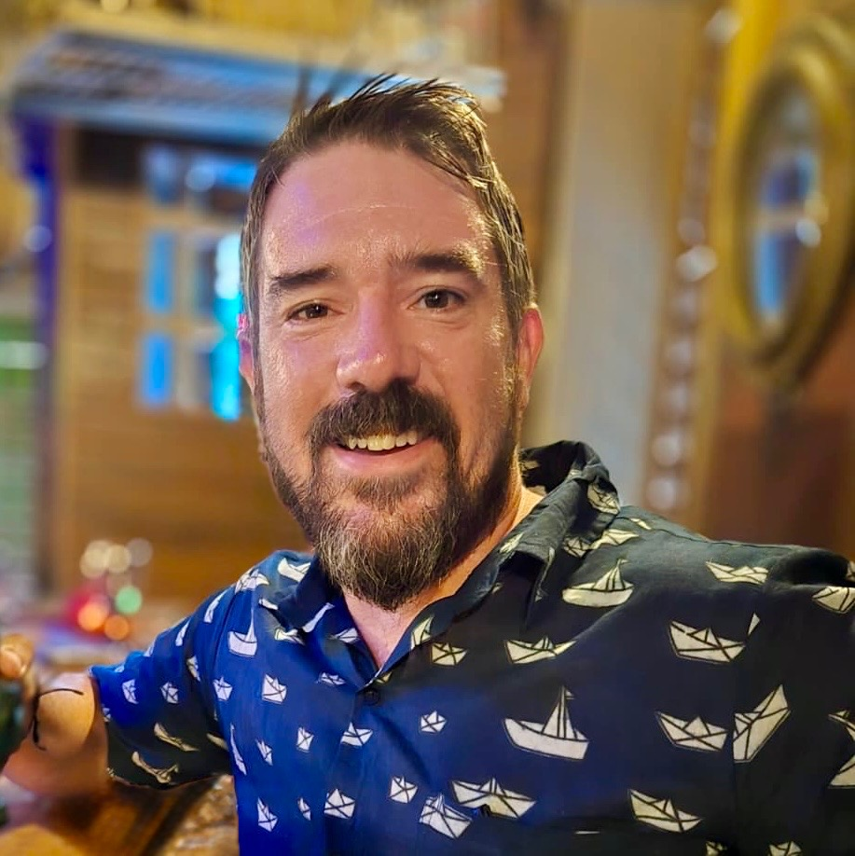
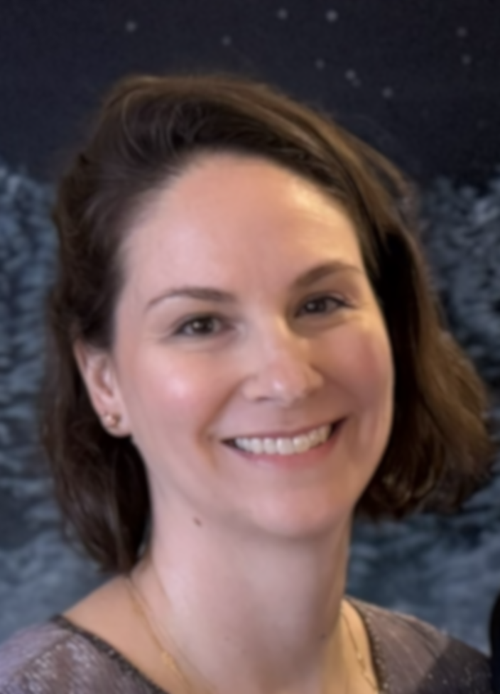
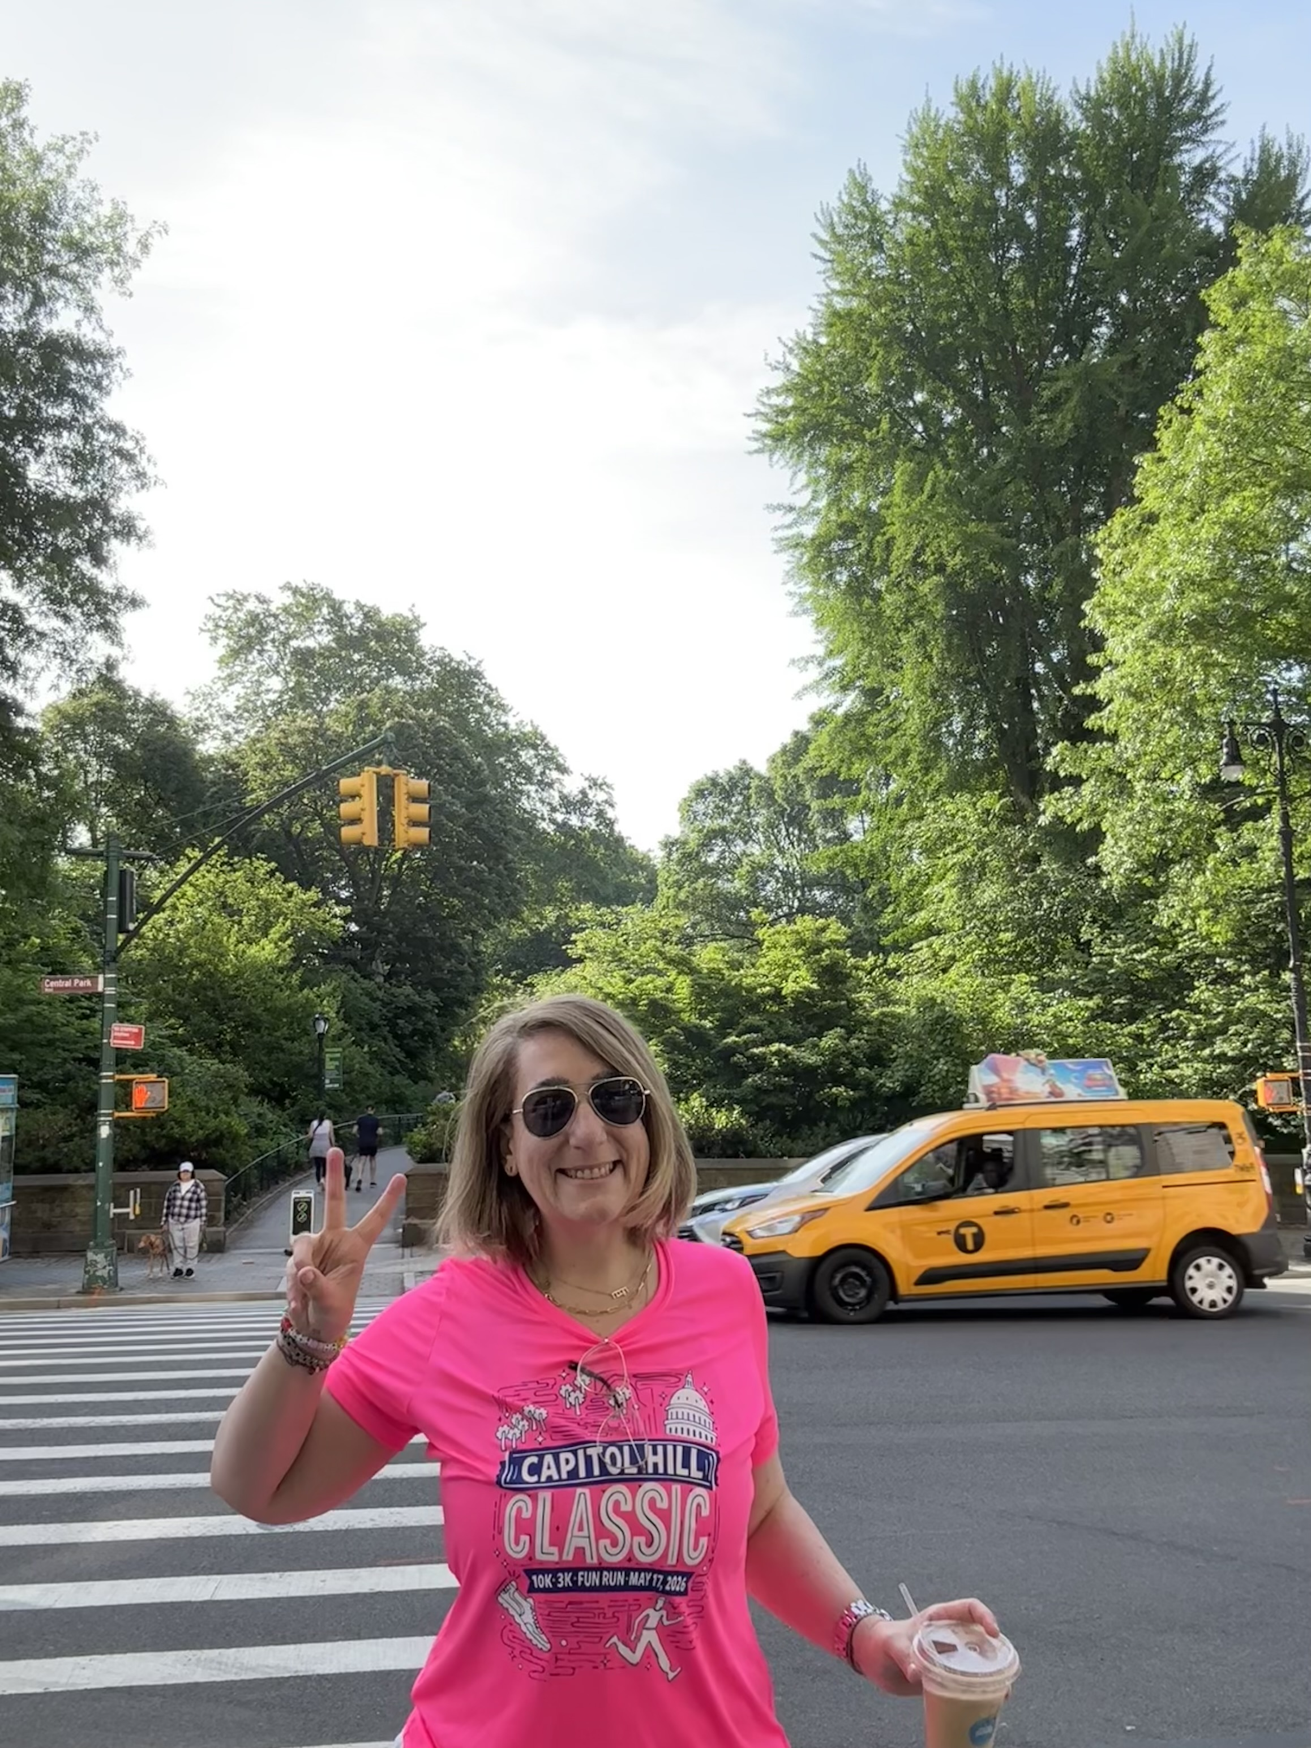
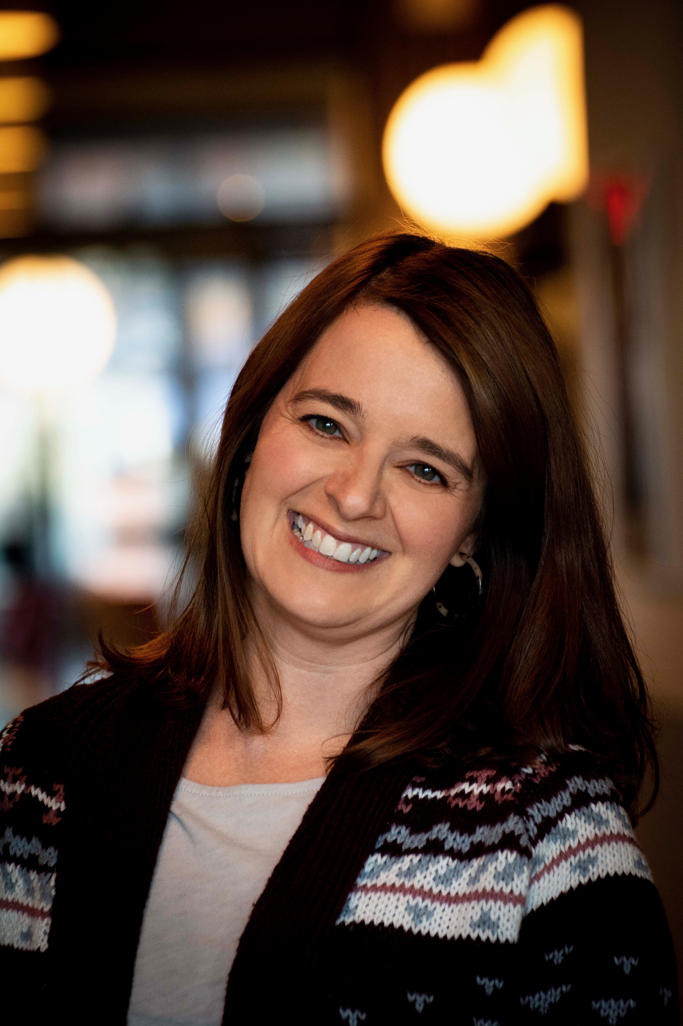
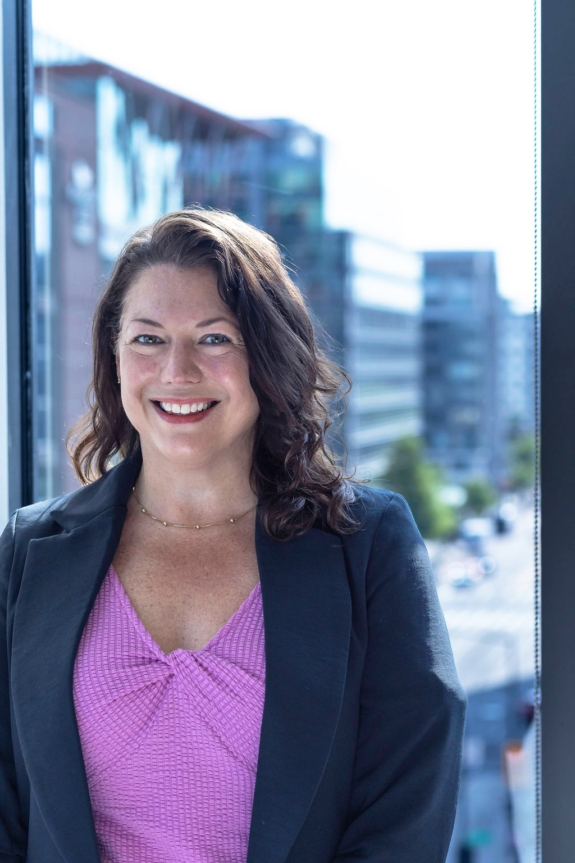
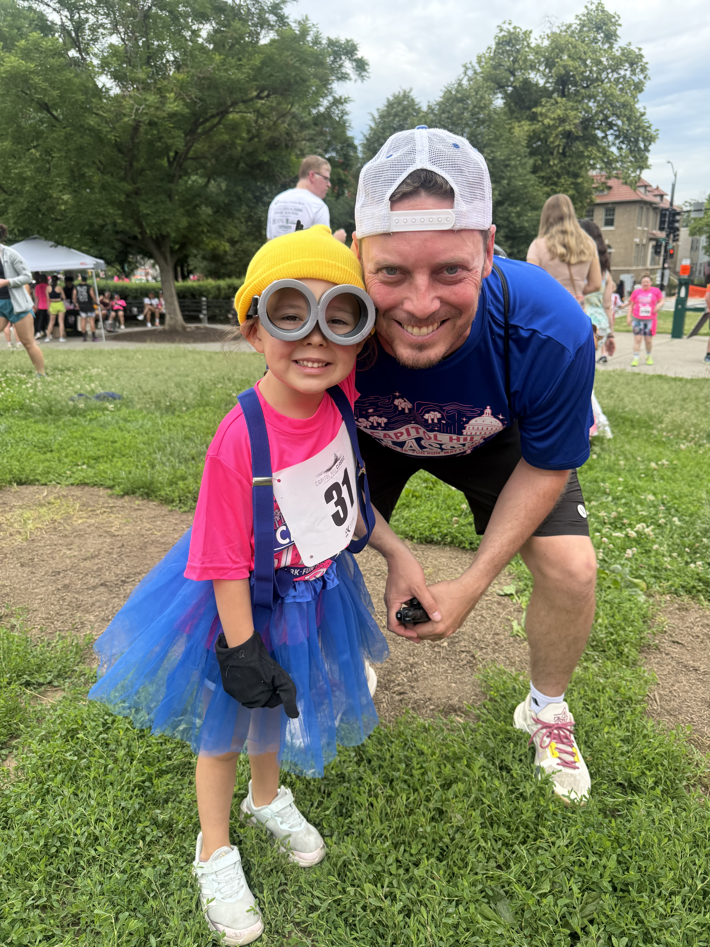
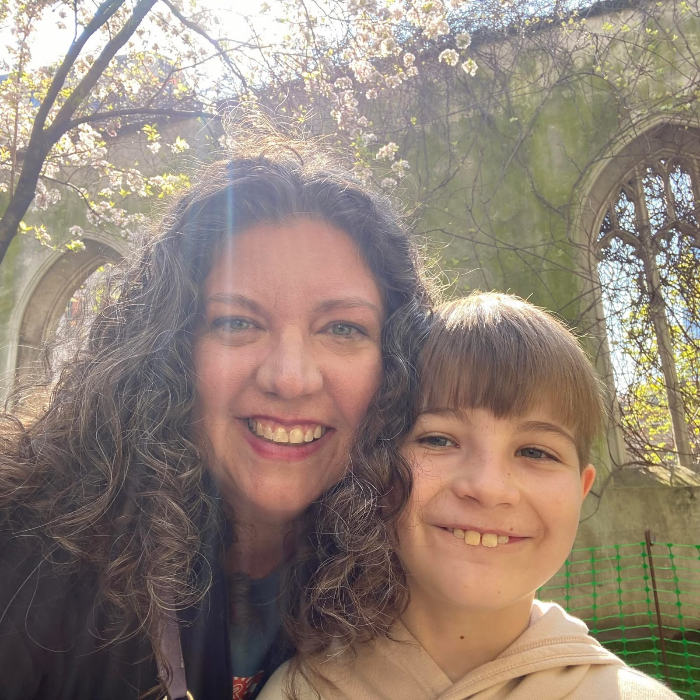
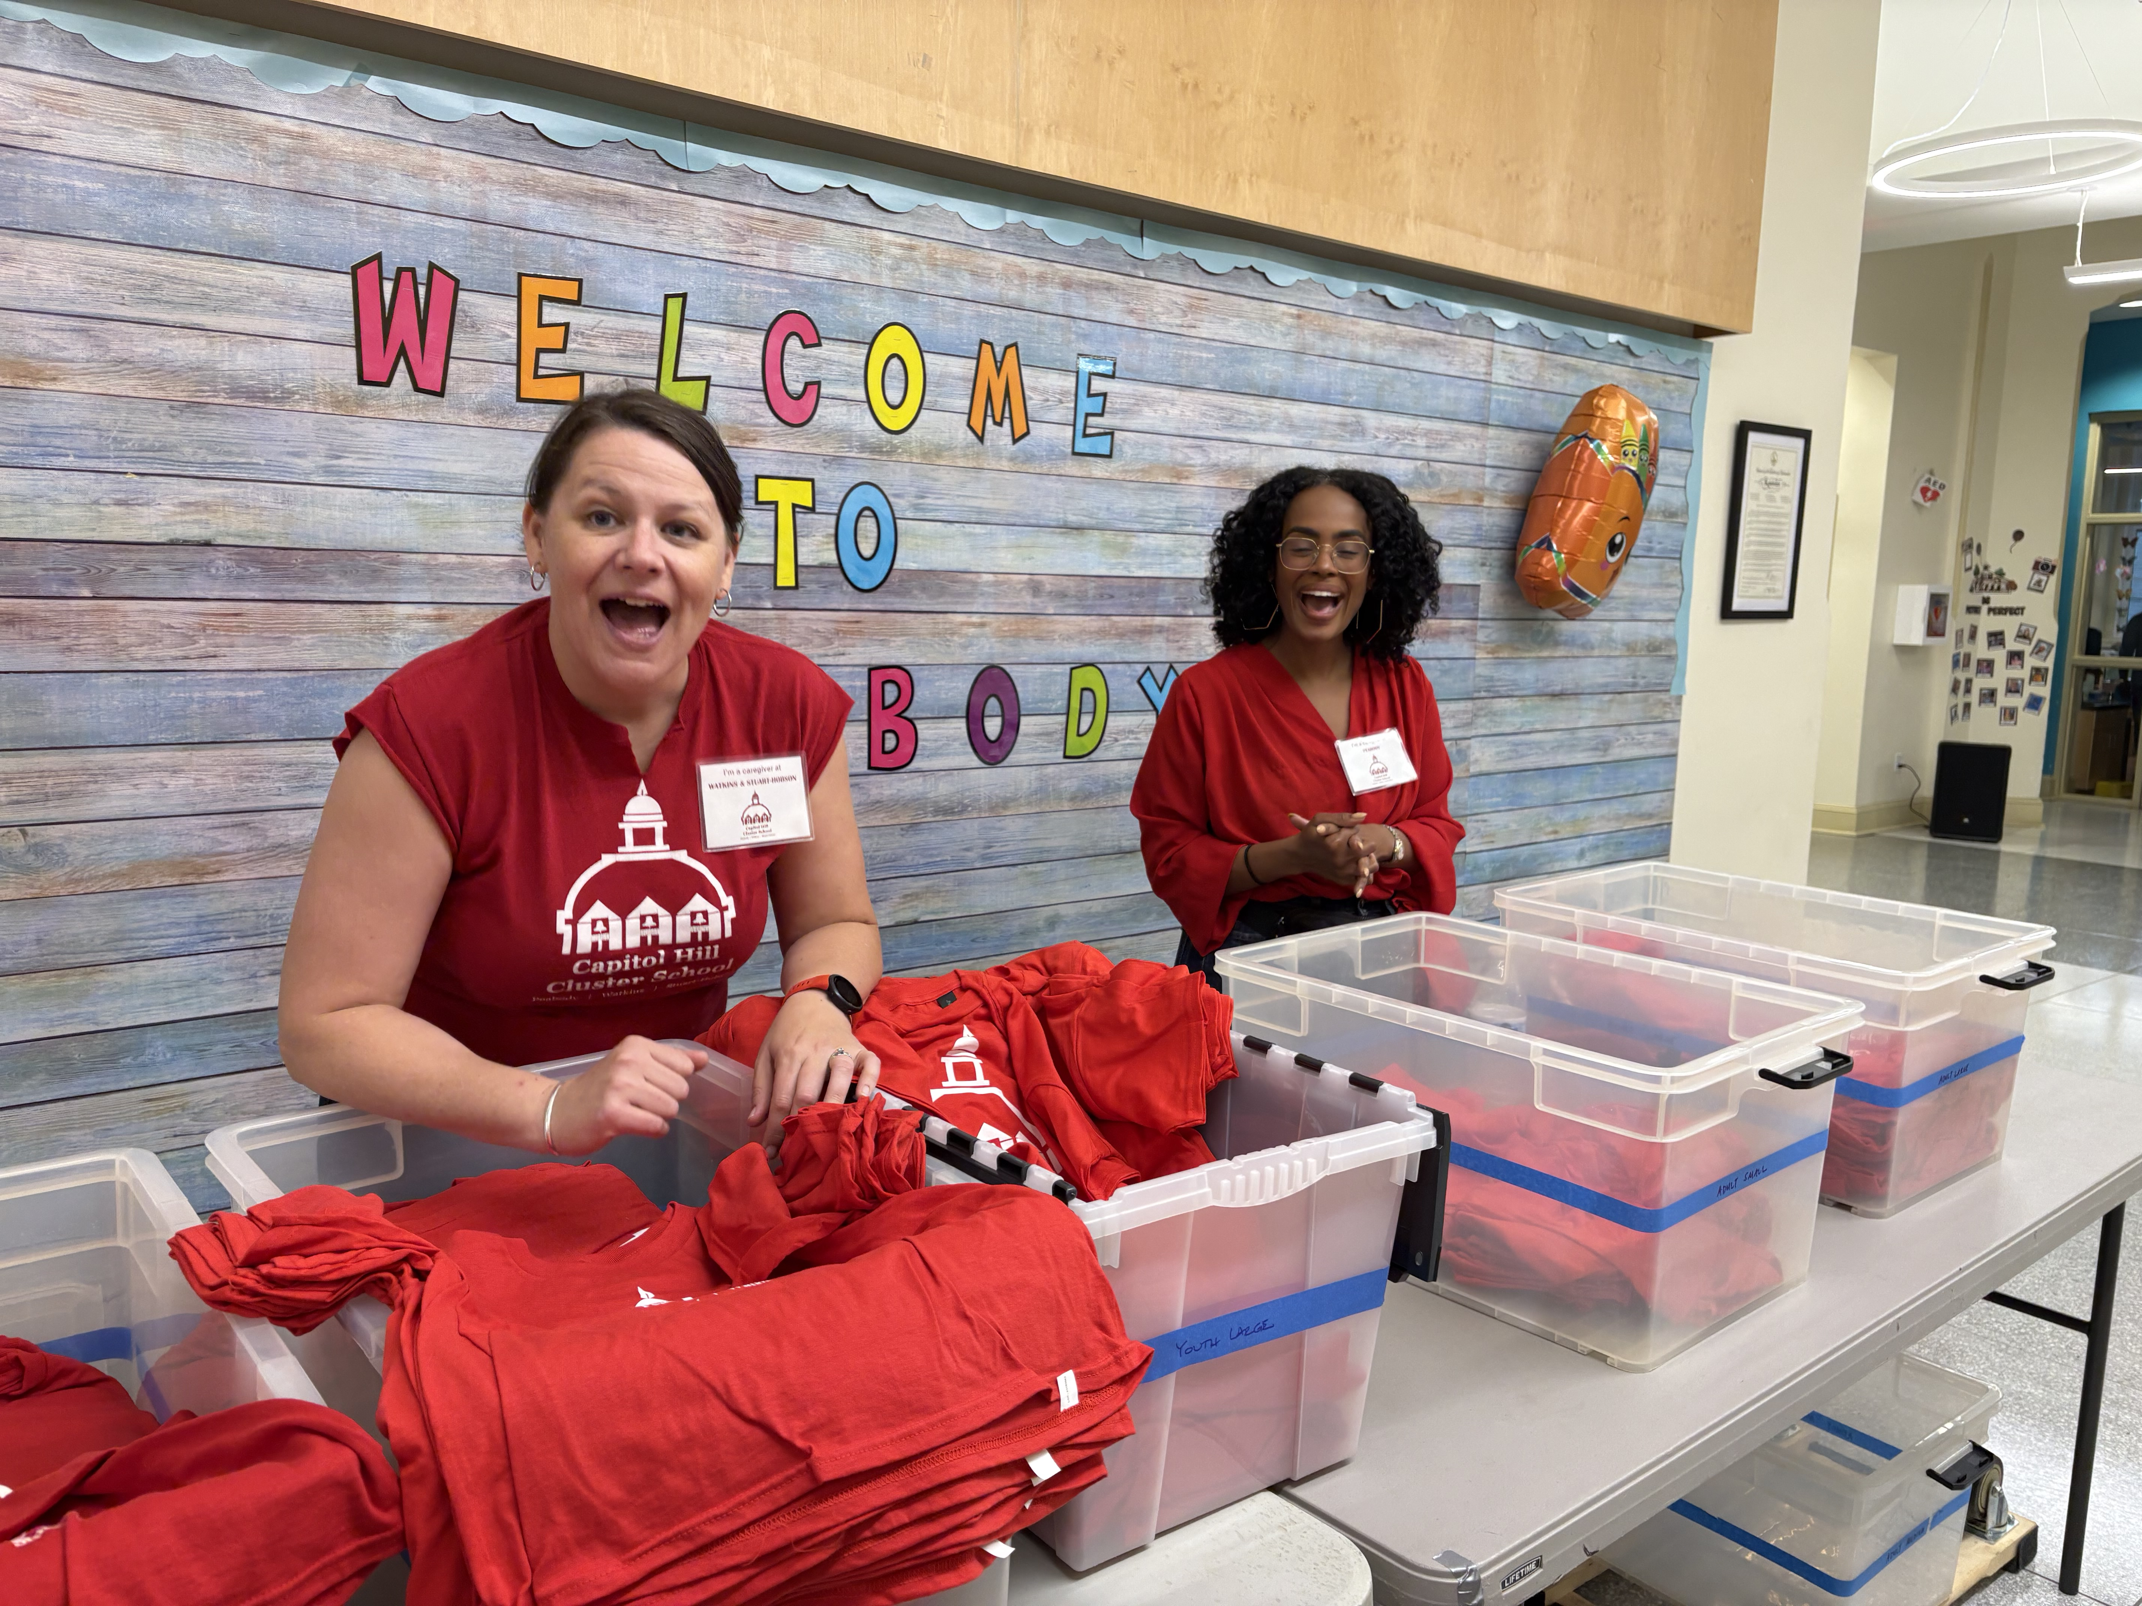
2026-27 Cluster PTA Executive Board
Chris Blanchard
President
Elisabeth Gagnon
VP, Campus Coordination
Rebecca Richelsoph
VP, Community
Carla Hall
Treasurer
Maggie Adams
Secretary
Zach Lowe
Communications
Catherine Lux Fry
Fundraising
Marci Vandiver
LSAT
Vacant
Advocacy
Vacant
Co-Treasurer

Slide 4

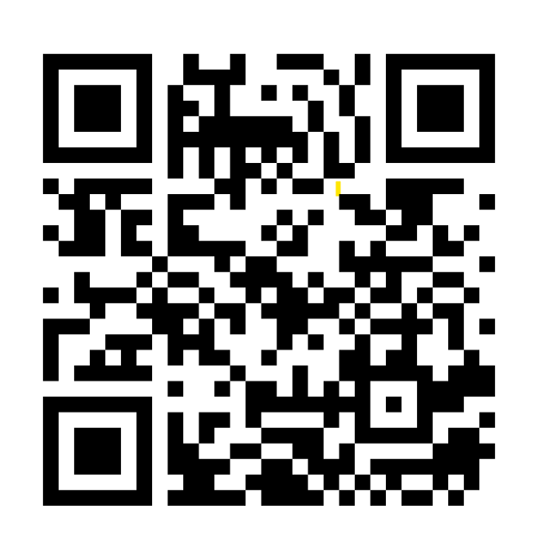
Cluster School 40th Anniversary

Slide 5
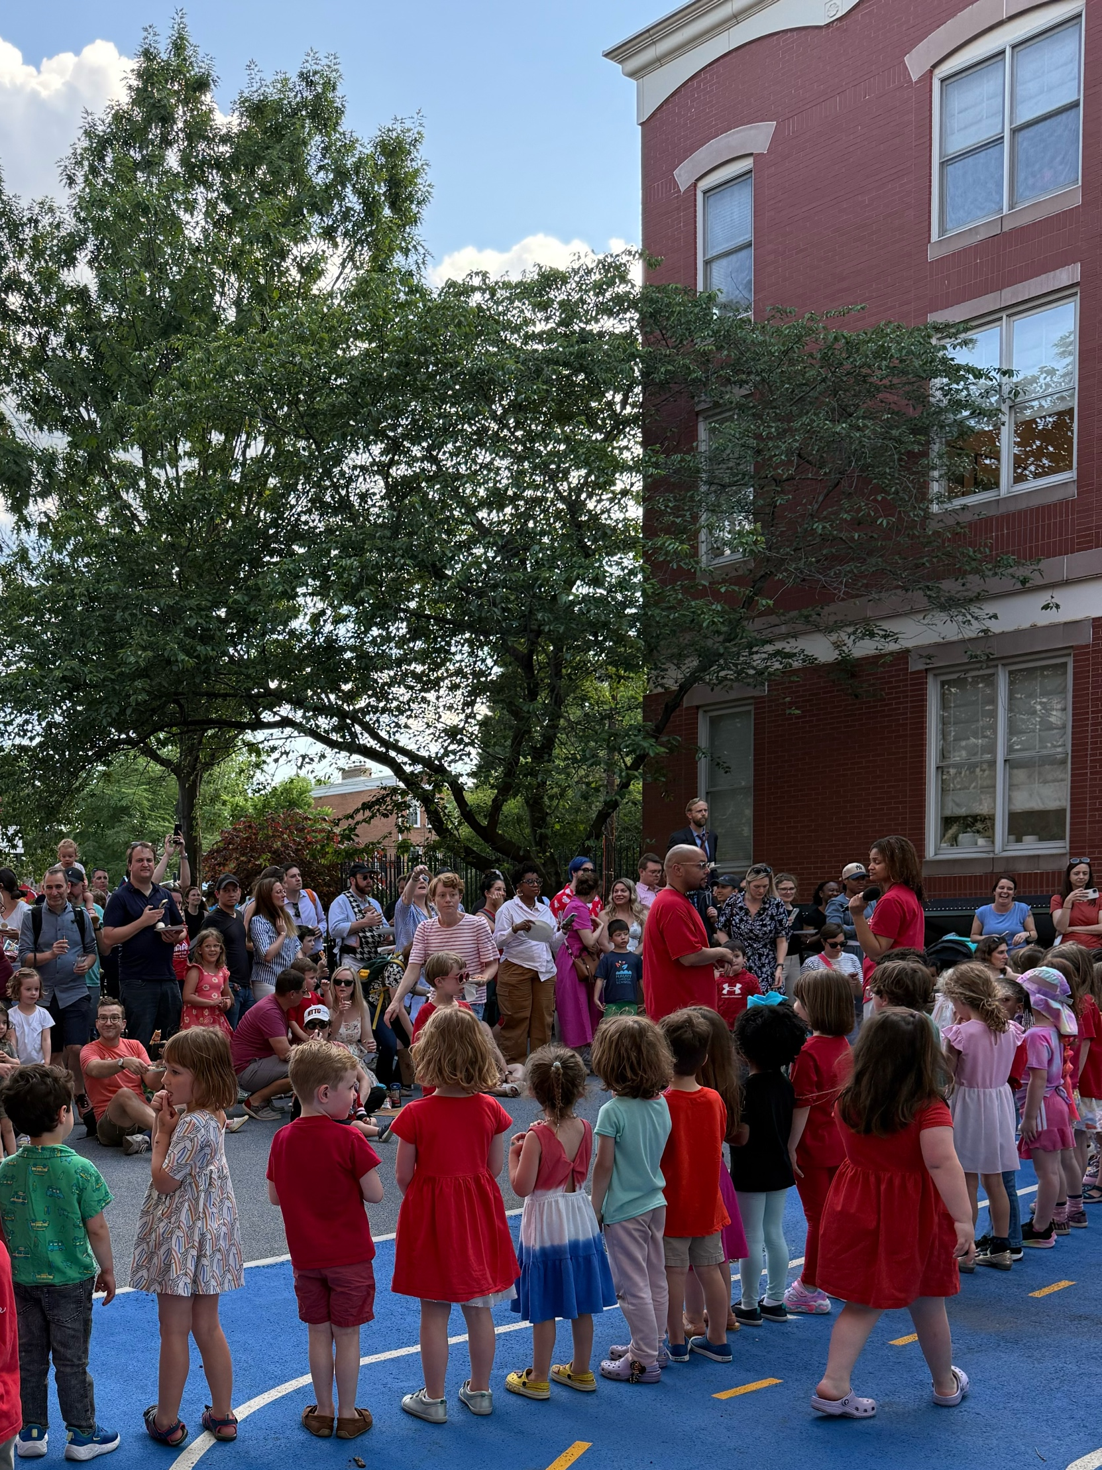
Campus Update: Peabody
Peabody Executive Committee
Parent Representatives | Teacher Representatives
Hali Voycik | Catherine Watts
Jesse Lirtzman | Pauline Frederic
Kristin Egan
Rita Livadas

Slide 6
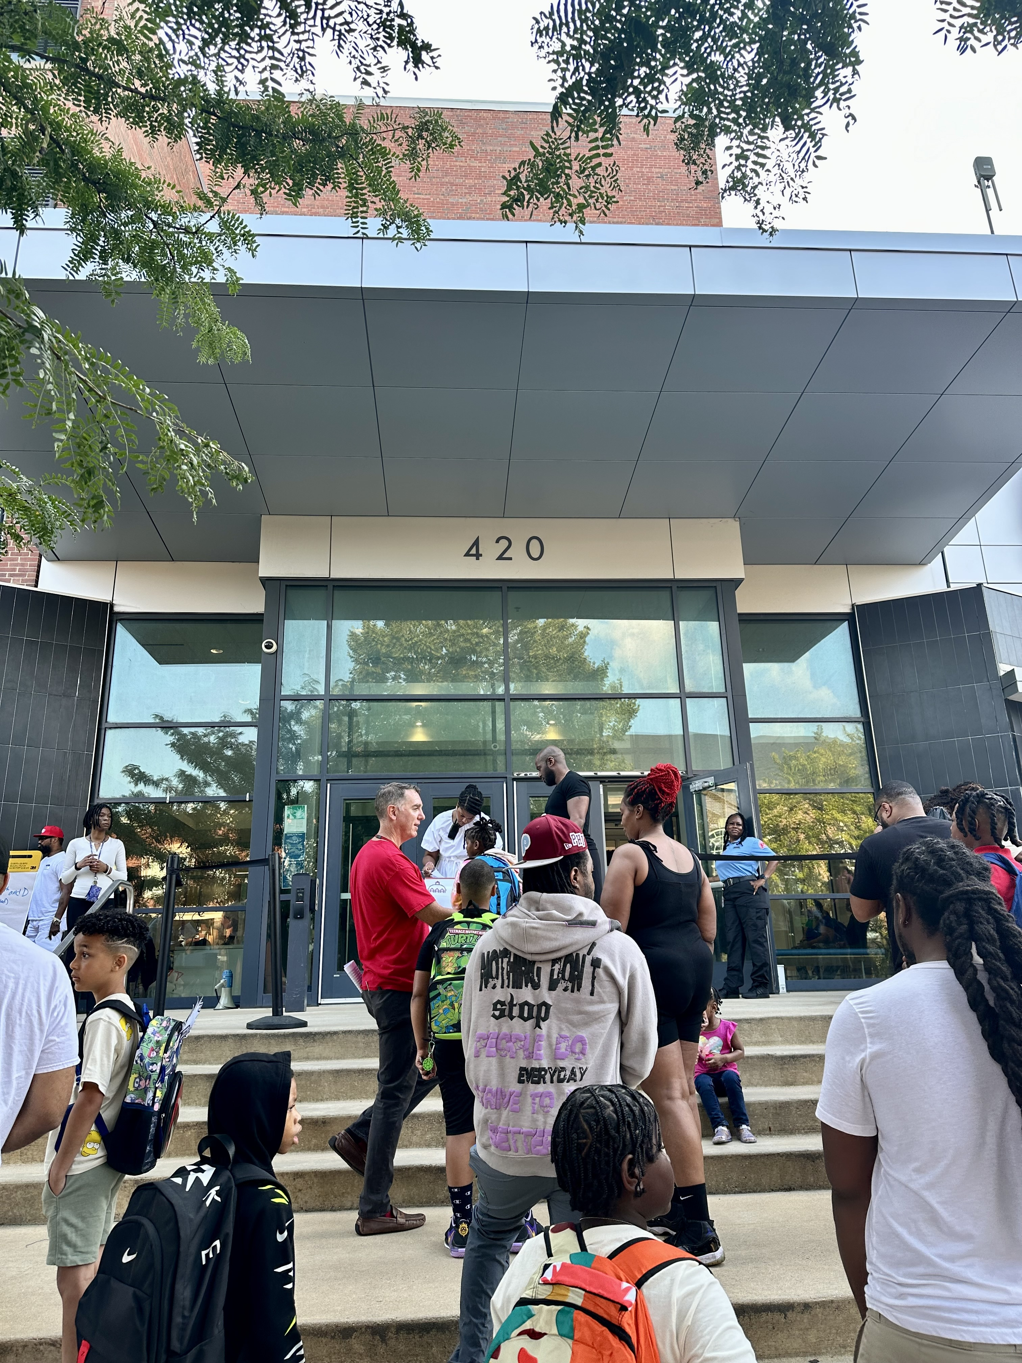
Campus Update: Watkins
Watkins Executive Committee
Parent Representatives | Teacher Representatives
Jamica El | Kelly Fox
Jill Keller | Mary Mackie
Kelli McAffee
Lauren Pauer
Laurie Wiesner
Marissa Gunn
Sara Dube

Slide 7
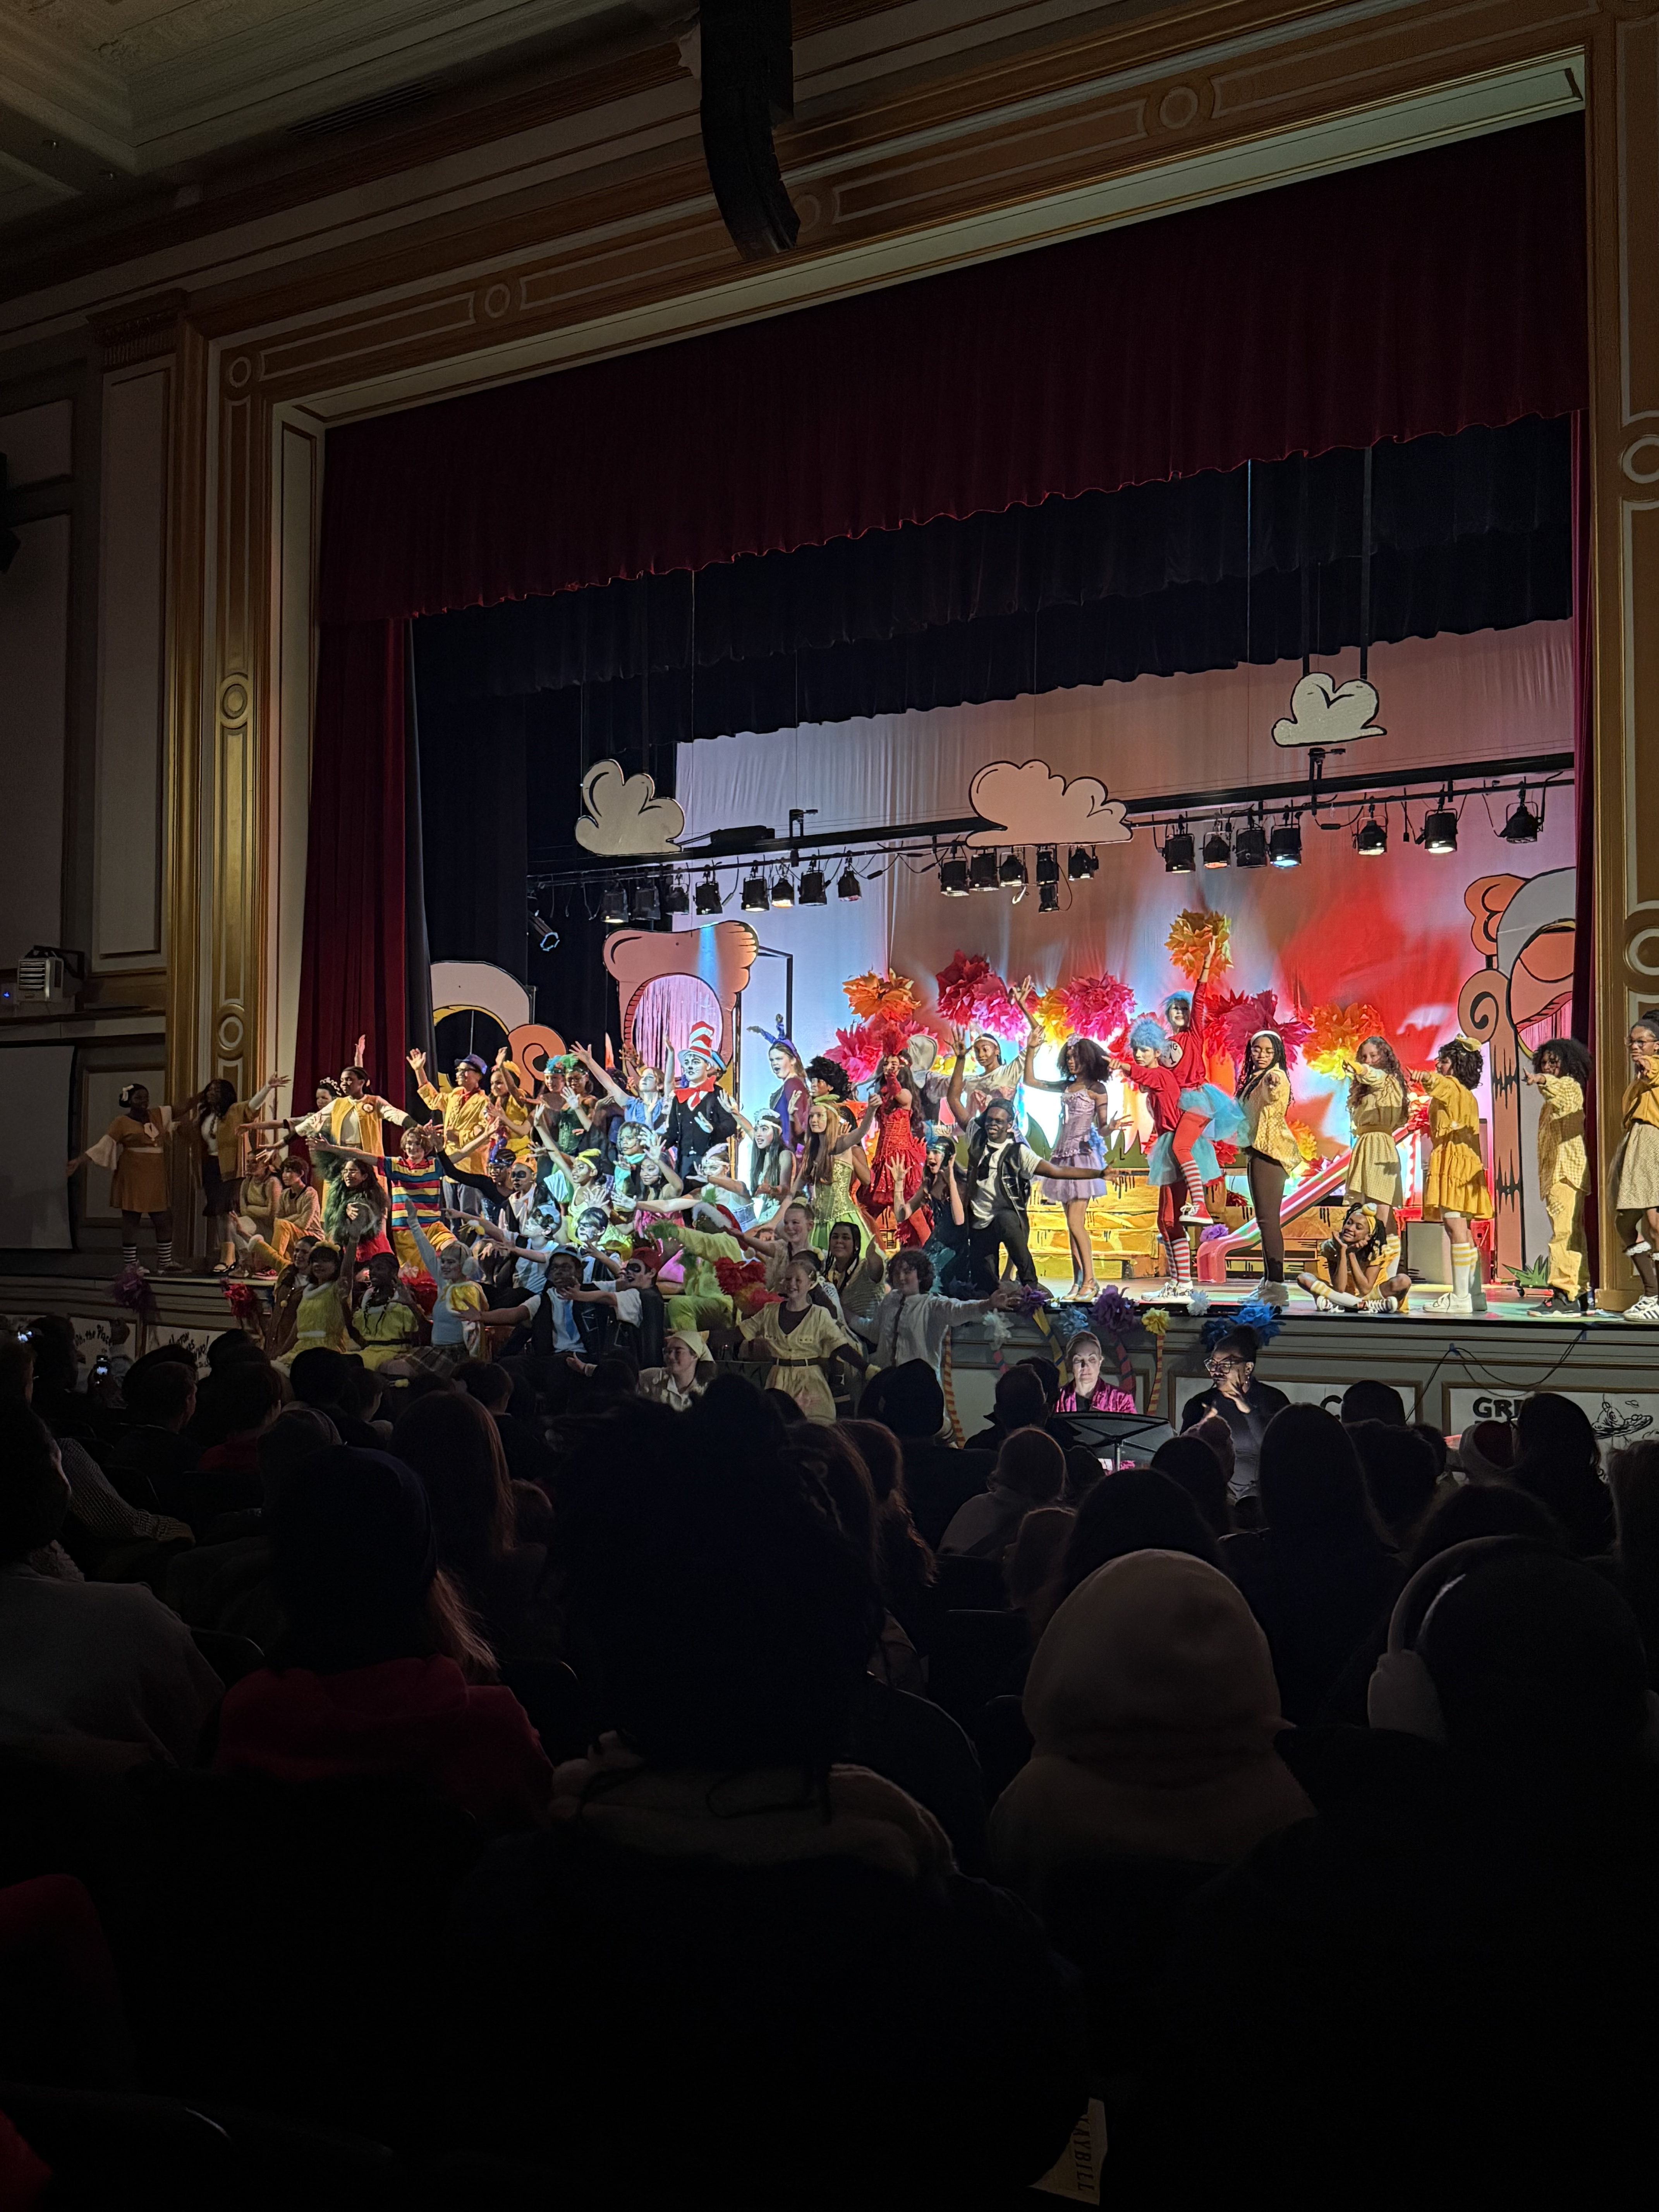
Campus Update: Stuart-Hobson
Stuart-Hobson Executive Committee
Parent Representatives | Teacher Representatives
Jenny Cheek | Christian Herr
Julia Pergola | Janette Ruiz
Qiana Hooker | Nicole Smith
Tom Guglielmo | Tiffany Kaijage

Slide 8
Our CHCS PTA Budget: The Big Picture
A quick look at our proposed SY26–27 budget
Where our PTA dollars come from — and how they support our three campuses

Slide 9
Where the Money Comes From
Donations
$10,000
Cluster Auction
$45,000
Classic
$165,000
House Tour
$27,000
Projected SY26-27 Revenue: $247,000

Slide 10
Planned spending
Each campus is allocated $180 per student
based on enrollment.
Stuart-Hobson
$99,000
Watkins
$72,000
Peabody
$36,900
PTA Operating Expenses
$36,000
Total Planned Spending: $273,900

Slide 11
Peabody ES: How We Decide What to Fund
Campus Budget: $36,900
(Estimated 9/16)
Academic Support
Field Trips
Food Prints
Garden/Playground
Maintenance
Social Activities &
Family Events
Teacher &
Staff Appreciation

Slide 12
Watkins ES: How We Decide
What to Fund
Campus Budget: $72,000
(Estimated 9/16)
Academic
Support
Community of
Caring
Athletics
Field Trips
Social Activities
& Events
Teacher &
Staff Appreciation
Food Prints

Slide 13
Stuart-Hobson MS: How We
Decide What to Fund
Campus Budget: $99,000
(Estimated 9/16)
Academic
Support
Athletics
Community
of Caring
Instrumental
Music
Theater
Visual Arts
Library
Debate
Principal's
Stipend
Community
Events
Teacher & Staff
Appreciation
6th Grade Activities
& Support
7th Grade Activities
& Support
8th Grade Activities
& Support
SPED
Staff Stipends
Custodial Staff
Security &
Crossing Guards
Club Lines

Slide 14
There’s More to the Story
The PTA budget is our starting point — campuses may have
additional resources to support students and staff.
Prior-Year Surplus
Campus Leadership Fund
Other Campus Revenue
Campuses can also bring in funds through grants and fundraising. Book fair proceeds go directly to each campus Library Fund; other examples include department grants and swag sales.
We have funds carried over from previous years that can support needs beyond this year’s projected revenue.
$30,000 from surplus is set aside for the Campus Leadership Fund (CLF) and allocated across the three campuses based on enrollment.
Bottom line:
The campus allocation is important, but it isn’t the full picture.

Slide 15

Call to Action!
Have a recently renovated house?
Have graphic design skills?
Day of Volunteer Support
Spread the word and join us!
Artwork created by: Zoe Lie-Venhuizen, SHMS, 8th Grader

Slide 16
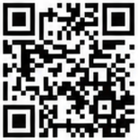
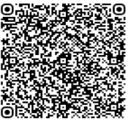
Spread the word and join us!
Looking to get more involved?
www.renovatorstour.org
RenovatorsHouseTour@chcspta.org

