Slide 1
Peabody and Watkins Reopen Community Corps Kick-Off Meeting #1 November 2020

Slide 2
Technical Housekeeping
RCC members raise hands to ensure they are presenters, not attendees.
APs will change status.
ASL interpreter identifies self in chat.
People in need "pin" ASL interpreter.
Attendees are always on mute.
Presenters stay on mute until called on.
Presenters can raise hands to be called on.
Anyone can ask questions at Q&A locations through the chat.

Slide 3
Agenda
Reopen Community Corps
Welcome
Framing and Overview – Why we are here today?
Update on DCPS Reopening Planning
Reopening Community Corps Overview and Goals
School Specific Needs for In-Person Learning
Next Steps
Notes:
Morning/Afternoon/Evening- and thank you for being here. I am very excited to kick-off the first of several Reopen Community Corps meetings for XXX School.
I appreciate the time you are giving toward this new engagement effort- it's very important work and you represent a critical stakeholder group that plays a very important role in thinking through how we continue to reopen strong together.
The agenda for today is:
Welcome and Opener
Framing and Overview – Why we are here today
Update on DCPS Reopening Planning
Reopening Community Corps Overview and Goals
School Specific Needs for In-Person Learning
Next Steps
It's also important we go over how to use Teams and the Chat feature and hand-raising feature.
In order to ensure that we are monitoring our air time we should use these functions.
I will share the deck after the meeting as well.

Slide 4
Who is at the Table?
Reopen Community Corps
Parents
Teachers
Staff
Students (next time?)
Community members
Notes:
Before we get started it's important we have a better understanding of who is in the room today:
Let's go around and introduce ourselves – please say your name, your role and why you are here today.

Slide 5
Warm-Up
Reopen Community Corps
In the chat please share:
What is one thing you think is going well in school this school year?
What is one thing you’d like to see improved in school?
Notes:
It's important we are in the right state of mind as we begin our conversation today. As a warm, please spend the next 1-2 minutes thinking about the following two questions and adding your ideas into the chat. We will then take 2 share-outs to the group:
What is one thing you think is going well in school this school year?
What is one thing you’d like to see improved in school?

Slide 6
Agenda
Reopen Community Corps
Welcome and Opener
Framing and Overview – Why we are here today
Update on DCPS Reopening Planning
Reopening Community Corps Overview and Goals
School Specific Needs for In-Person Learning
Next Steps
Notes:
Thank you for sharing.
Let's move on to the next agenda time- a bit of framing for today- why are we here?

Slide 7
Meeting Purpose
Reopen Community Corps
Understand why we are here as the Reopening Community Corps and align around a shared vision and purpose.
Understand current reopening plans for DCPS.
Discuss baseline expectations and key questions for Term 3.
Discuss school needs and goals for In-Person Learning.
Notes:
Again, as mentioned earlier I am very grateful for your presence here today as this is a very important process to our school community.
Today with our first kick-off meeting we hope to:
Understand why we are here as the Reopening Community Corps and align around a shared vision and purpose.
Understand current reopening plans for DCPS.
Discuss baseline expectations and key questions for Term 3.
Discuss school needs and goals for In-Person Learning.

Slide 8
Engagement Pillars: In-Person Learning
Reopen Community Corps
Leverage collaborative planning structures (“reopen community corps”) to understand school-specific context for feedback and school planning.
Commit to baseline expectations to ensure equity of access and opportunity across DCPS.
Maximize the short window of time (November to early December) to engage in Term 3 planning before implementation needs to occur.
Notes:
As this is a new engagement process I wanted to take a minute to ground our work in three pillars:
1. Leverage collaborative planning structures (“reopen community corps”) to understand school-specific context for feedback and school planning.
2. Commit to baseline expectations to ensure equity of access and opportunity across DCPS.
3. Maximize the short window of time (November to early December) to engage in Term 3 planning before implementation needs to occur.

Slide 9
Pairs of Issues
Reopen Community Corps
DCPS will address:
Staffing
Survey for Community Demand
This team will address:
Instructional Model
Assessing community demand
Notes:
As this is a new engagement process I wanted to take a minute to ground our work in three pillars:
1. Leverage collaborative planning structures (“reopen community corps”) to understand school-specific context for feedback and school planning.
2. Commit to baseline expectations to ensure equity of access and opportunity across DCPS.
3. Maximize the short window of time (November to early December) to engage in Term 3 planning before implementation needs to occur.

Slide 10
Agenda
Reopen Community Corps
Welcome and Opener
Framing and Overview – Why we are here today
Update on DCPS Reopening Planning
Reopening Community Corps Overview and Goals
School Specific Needs for In-Person Learning
Next Steps
Notes:
Moving on in the agenda...
Before we get started with the work at hand I want to make sure everyone has a clear understanding of where DCPS Reopening work stands and some key updates around health and safety as well as the updates for Term 2 and Term 3 planning.
Things have been moving fast so its important we all know what is happening in order to understand where we are going.

Slide 11
DCPS Planning Principles
Reopen Community Corps
Notes:
As I share more information on how we'll bring staff and students back safely, I want to ground us in the DCPS planning principles that have served as a north star for our planning.
Prioritizing safety - at the front of our mind and we have very robust protocols for health and safety
Maximizing learning -both at home and school - want them to maximize every moment of our instructional day
Equity - continues to be a priority - equity and access to resources, equity in learning opps - students have different needs and this looks different across our district and this continues to be top priority for us.

Slide 12
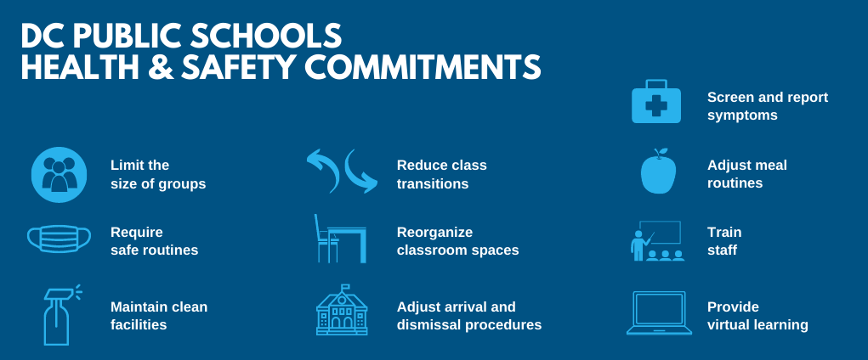
Health & Safety Protocols
Reopen Community Corps
Notes:
You have likely seen this information before, but it also serves as a reminder of our 10 top commitments to bringing our staff and students back safely.
DCPS has remained consistent with these commitments and represents how we are operationalizing the health guidance that's come from DC Health, OSSE, and the CDC.

Slide 13
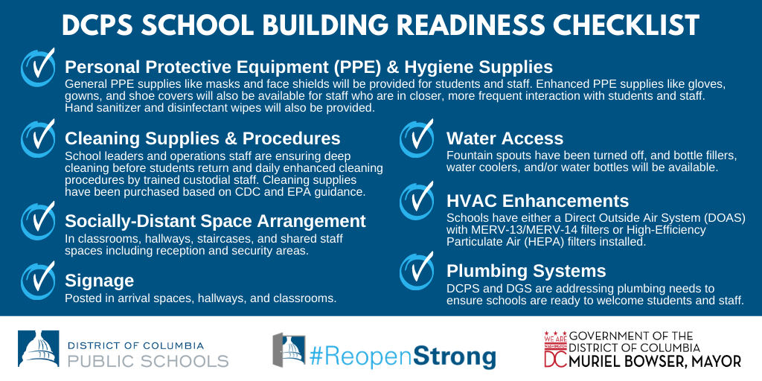
School Preparations: Building Readiness
Reopen Community Corps
Notes:
As we ready our schools and ensure our buildings are ready – these are the key components we are focused on:
- PPE
- Cleaning Supplies and procedures
- Socially distanced space
- Clear signage
-Water access
-HVAC Enhancements
-Plumbing systems addressed

Slide 14
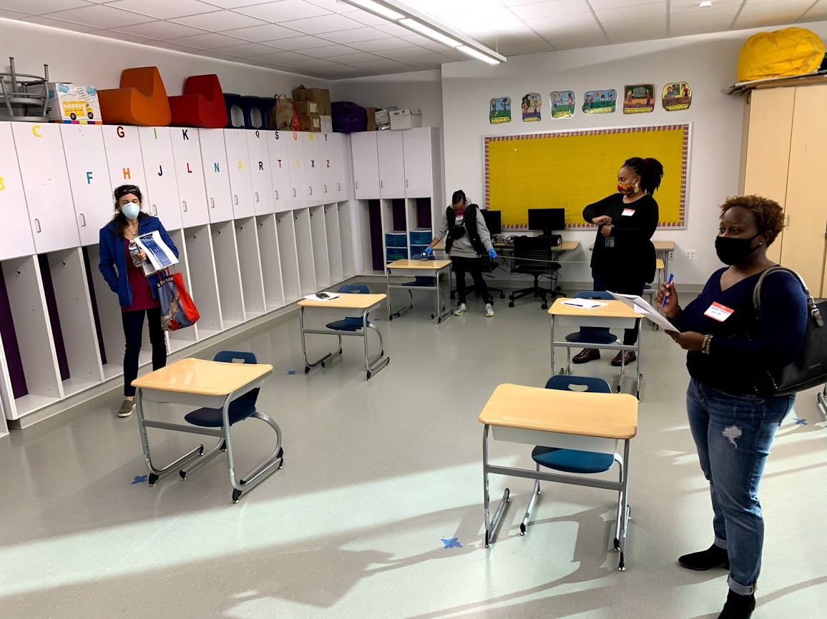
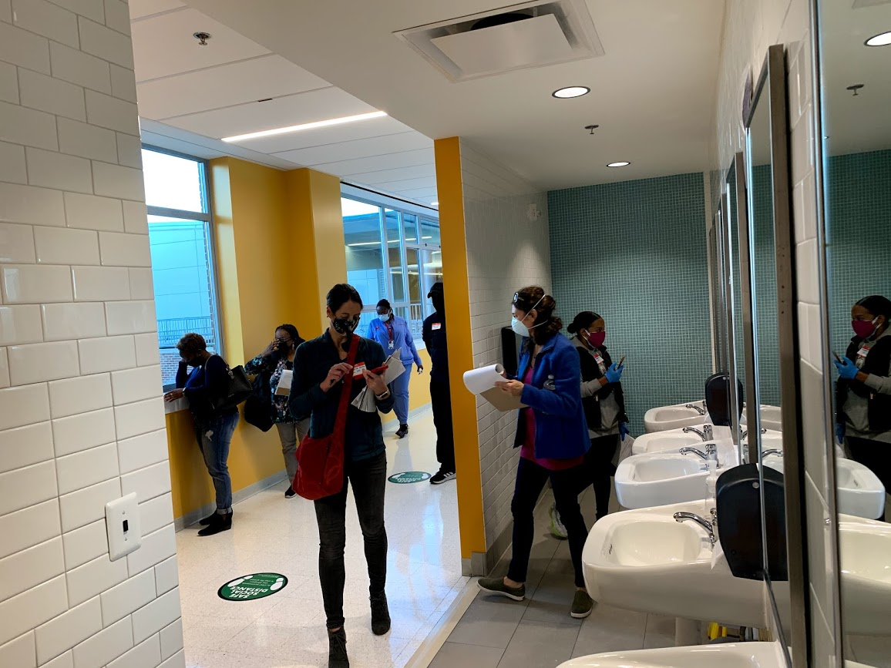
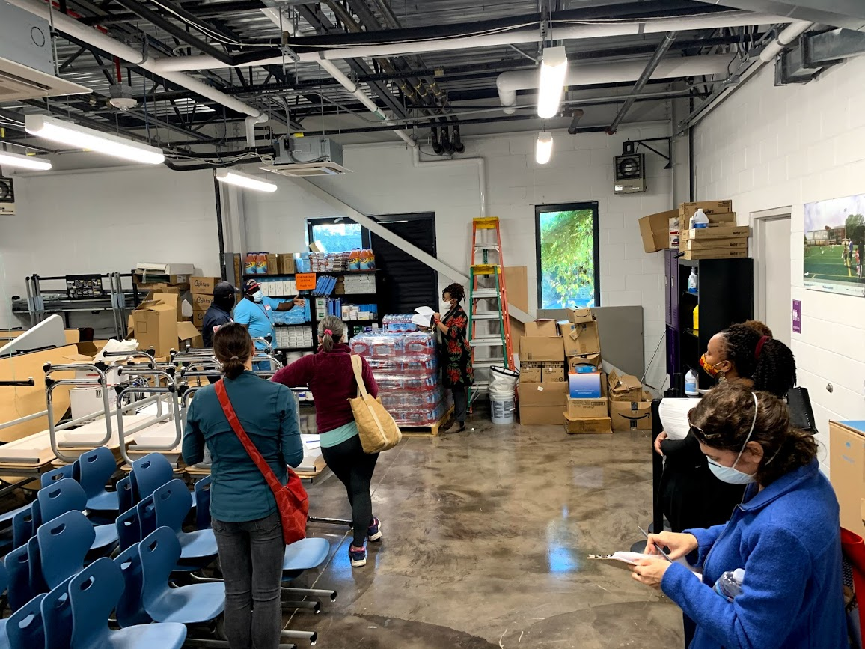
Building Readiness in Action
Reopen Community Corps
During building walkthroughs, community members used a detailed version of the checklist to note their observations on how a school is getting ready to safely reopen and better understand
what the reopening operations plan means for students and staff in Term 2.
Notes:
These are pictures of our building walkthroughs from the last few weeks. Mixed groups of stakeholders have been involved – teachers, parents, community and school leaders.
INSERT IMAGES OF YOUR SCHOOL SPECIFIC WALKTHROUGHS HERE

Slide 15
Health and Safety At-a-Glance
Reopen Community Corps
$24M investment to increase the air change rates and filtration
3,000 mobile medicate grade HEPA
(High-Efficiency Particulate Air) filters
$3.6M investment for Personal Protective Equipment
1.5M Disposable Masks
320,000 Child Size Masks
80,000 Communicator Masks
87,000 Face Shields
Notes:
We have consistently prioritized health and safety.
It’s why we rolled back plans this summer.
It is reflected in over $31 million of investments in safety measures for schools, including $3.6 million for additional PPE, $4.5 million in building readiness, and $24 million toward HVAC enhancements.
We are already implementing all health and safety measures raised by the WTU – for ALL our staff.

Slide 16
DCPS’ Response to COVID-19
Reopen Community Corps
If students, staff, or community members, who have been in the building, test positive for COVID-19, schools will follow the health and safety guidance released by DC Health and the Office of the State Superintendent of Education.
To minimize the impact of a positive case on the entire school, students will be grouped in cohorts that do not have close contact with other cohorts.
DCPS is training school leaders on our COVID-19 Reporting and Response Protocol.
When there is a confirmed, positive case of an individual in a school building, we will notify students and staff of that school, provide self-quarantine instructions to close contacts, and follow all steps outlined by DC Health and the CDC for cleaning, disinfection, and sanitization.
Notes:
We commit to keeping you informed on COVID-19 public health notices in our school.
Through the DCPS COVID-19 Response Protocol, staff members will be trained to confidentially report potential exposure in a school building. If there are any confirmed cases of COVID-19 reported to DCPS by a student, family, or staff member — whether they have been in a school building or not — we will share that information with DC Health for contact tracing purposes.
The DC Health Contact Trace force will interview the individual to identify other close contacts outside of the school; reach out to all quarantined contacts to provide information on the precautions to follow while in quarantine; and assist individuals in obtaining resources they may need during their quarantine period.

Slide 17
Current Operating Status: CARE Classrooms and Student Support Centers
Reopen Community Corps
Term 1: 100% Learning at Home + Student Support Centers
Term 2: Learning at Home + Student Support Centers and CARE Classrooms
Term 3: Learning at Home + Student Support Centers and CARE Classrooms + In-Person Learning
Notes:
Now that you understand a bit more about our health and safety priorities and approach, I want to make sure you have the full picture of our reopening plans.
This graphic gives a preview term by term – right now we are at the start of term 2! DCPS has three learning models:
- Learning at home
-Student Support Centers at some schools
- CARE Classrooms starting November 18 in some ES/EC schools

Slide 18
Term 2 Status
Reopen Community Corps
Our Commitment: DC Public Schools has a responsibility to provide every student with an equitable, rigorous, and joyful education — no matter if they are learning at home or learning in school.
Term 2 Update: All students are continuing with learning at home, but CARE Classrooms will open at select elementary schools starting on November 18. Watkins will open a 1st grade classroom on December 2nd.
Why: We commit to supporting our students, families, teachers, and staff in our urgent mission to safely reopen schools. We recognize many in our community expressed concerns about #ReopenStrong plans, and we will use this moment to adjust our timeline and staffing plans for reopening.
Path Forward: We are still taking steps to prepare our buildings for safe reopening and will connect with families who are matched with seats for one of our in-person learning options on next steps.
Notes:
Term 2 Update: While we planned to offer in-person learning at the start of Term 2 for select elementary school students, this timeline will need to be adjusted. All students will now continue Term 2 on Monday, November 9 with learning at home.
DCPS is committed to prioritizing in-person learning seats for students furthest from opportunity. With the delay in opening of In-Person Learning (IPL) classrooms, students enrolled by October 5 (excluding self-contained special education students) who fall within the following categories will get a preference for the available CARE classroom seats:
Students who already accepted an In-Person Learning seat
Students experiencing homelessness
English Learners and Students with Individualized Educational Plans (IEPs)
Students identified as at-risk (This includes students in the foster care system, and students who qualify for TANF or SNAP.)

Slide 19
Prioritizing Virtual Learning in a Classroom (CARE Classrooms)
Reopen Community Corps
Learning Model
Staff Role
Students learn virtually with their teacher and class online.
Students spend their day at school with a group of their peers.
Students will have the opportunity to safely socialize with their peers during breaks, recess, and lunch.
Supervision and support is provided by a caring adult.
Breakfast and lunch are provided.
Maintain a positive learning environment for students.
Support students with accessing learning materials online.
Provide additional support for students who need individualized attention.
Ensure health and safety protocols are followed.
Facilitate safe arrival, transitions, and dismissal.
Maintain ongoing communication with families.
Staffing
Qualifications
DCPS instructional and support staff
Partner staff (e.g. DC Gov and community-based organizations)
Active background check, including fingerprinting and TB screen
High School diploma and 24 hours college credit (minimum)
Preferred: Experience working with children (particularly for grades PK-2).
Notes:
Although DCPS will no longer plan to offer In-Person Learning (IPL) beginning November 9, the district is committed to providing in-person opportunities to those students who were already offered seats and to expand in-person opportunities when possible. DCPS plans to prioritzie those students who previously accepted IPL seats for the available CARE seats with the long-term goal of shifting these students to IPL. The district will also begin to offer additional CARE seats as staffing allows.
Walk thru slide.

Slide 20
CARE Classroom At-a-Glance
Reopen Community Corps
Notes:
On this slide you will see an example of what an average day in a CARE classroom might look like, though our school average day might look a little different.
*Flag- these talking points might need to vary school by school.

Slide 21
Open Questions & Answers
Reopen Community Corps
Notes:
I know we are close to time but wanted to take any questions you might have and clarity around next steps.
Our next meeting will be after the Thanksgiving Break on XXXX (share if you have date).

Slide 22
Agenda
Reopen Community Corps
Welcome and Opener
Framing and Overview – Why we are here today
Update on DCPS Reopening Planning
Reopening Community Corps Overview and Goals
School Specific Needs for In-Person Learning
Next Steps
Notes:
Let's turn now to the reason we are all here- the Reopen Community Corps

Slide 23
Engagement Pillars: In-Person Learning
Reopen Community Corps
Leverage collaborative planning structures (“reopen community corps”) to understand school-specific context for feedback and school planning.
Commit to baseline expectations to ensure equity of access and opportunity across DCPS.
Maximize the short window of time (November to early December) to engage in Term 3 planning before implementation needs to occur.
Notes:
As mentioned earlier around the purpose for this work, we have three pillars of engagement for In-Person Learning:
Let's talk first about this one:
1. Leverage collaborative planning structures (“reopen community corps”) to understand school-specific context for feedback and school planning.

Slide 24
Reopen Community Corps Goals
Reopen Community Corps
Leverage collaborative planning structures (“reopen community corps”) to understand school-specific context for feedback and school planning.
A Reopen Community Corps* is a diverse group of school-level stakeholders consisting of parents, teachers, school staff, community member(s), and/or student(s) who support/advise the school leader in understanding models and their impacts on the community for reopening strong for In-Person learning and CARE Classroom in Term 3.
Notes:
Who are we? And why are we here together?
A Reopen Community Corps* is a diverse group of school-level stakeholders consisting of parents, teachers, school staff, community member(s), and/or student(s) who support/advise the school leader in understanding models and their impacts on the community for reopening strong for In-Person learning and CARE Classroom in Term 3.

Slide 25
Engagement Pillars: In-Person Learning
Engagement on Reopening - School Leader Overview
Leverage collaborative planning structures (“reopen community corps”) to understand school-specific context for feedback and school planning.
Commit to baseline expectations to ensure equity of access and opportunity across DCPS.
Maximize the short window of time (November to early December) to engage in Term 3 planning before implementation needs to occur.
Notes:
Now let's look at pillar number two:
2. Commit to baseline expectations to ensure equity of access and opportunity across DCPS.

Slide 26
Elementary Baseline Expectations: Summary
Engagement on Reopening - School Leader Overview
Students
Schools should meet family demand for student seats (thoughtfully designed use of CARE or In-Person Learning) up to the capacity of the school
Talent
Schedule
All students should be engaged in learning with teachers on all instructional days – whether in school or at home.
Safety and Operations
All DCPS health and safety protocols outlined must be adhered to (for example, cohorts of students remain together, classroom caps, etc.)
Teachers will work directly with students in-person, including self-contained (In-Person Learning Classes)
Staff members will be able to work with groups of students learning virtually at school (CARE Classes)
Students will continue to follow the DCPS curriculum and continue to receive instruction in all content areas
Within the offered grade levels and classes at a school, students who have already been offered a seat will be offered a seat first; new seat offers will be provided in order of the existing selection methodology (may include offering from the current waitlist and/or discretion within the principal appeals process)
IPL students should be in the building with DCPS teachers at least 4 days but no more than 4.5 days per week, in one or two groups (students attend 4 days per week Monday, Tuesday, Thursday, Friday; OR students attend 4.5 days per week, Monday, Tuesday, ½ day Wednesday, Thursday, Friday; OR an A group attends Monday/Tuesday and B group attends Thursday/Friday with Wednesday reserved for deep cleaning between groups).
CARE students continue with 4.5 day per week schedule.
Notes:
I know this is a crowed slide but it's important we understand that there are specific expectations around our students, our staff (our talent), our schedules and around safety that cannot be changed or compromised. We will be discussing how to make this plan our own-how to make it work for our school community- but this list here grounds us in what all schools must do:
For Students:
Elementary Expectations
Schools should meet family demand for student seats (thoughtfully designed use of CARE or In-Person Learning) up to the capacity of the school
Within the offered grade levels and classes at a school, students who have already been offered a seat will be offered a seat first; new seat offers will be provided in order of the existing selection methodology (may include offering from the current waitlist and/or discretion within the principal appeals process)
Students will continue to follow the DCPS curriculum and continue to receive instruction in all content areas
Students must continue to receive their specialized instruction and EL services
For Staff:
Elementary Expectations
Teachers will work directly with students in person (In-Person Learning Classes), including self-contained classes
Staff members will be able to work with groups of students learning virtually at school (CARE Classes)
For our Schedule:
Elementary Expectations
All students should be engaged in learning with teachers on all instructional days – whether in school or at home.
In-Person Learning students should be in the building with DCPS teachers at least 4 days but no more than 4.5 days per week, in one or two groups (i.e., students attend 4 days per week Monday, Tuesday, Thursday, Friday; OR students attend 4.5 days per week, Monday, Tuesday, ½ day Wednesday, Thursday, Friday; OR an A group attends Monday/Tuesday and B group attends Thursday/Friday with Wednesday reserved for deep cleaning between groups).
CARE students continue with 4.5 day per week schedule.
And for our Safety and Operations:
All Schools
All DCPS health and safety protocols outlined must be adhered to (for example, cohorts of students remain together, classroom caps, etc.)
Operational readiness must be assessed and completed

Slide 27
Within the baseline expectations, our Reopen Community Corps will engage on two key questions in November and December.
Reopen Community Corps
Instructional Model: How can the instructional model meet the baseline expectations and a school’s unique goals?
Grades/Classes: What is the best way to select which grades/classrooms to open for in-person learning (IPL) and CARE Classrooms for Term 3?
Notes:
Now- with those baseline parameters and expectations we will focus on two main questions and decisions as a group:
Instructional Model: How can the instructional model meet the baseline expectations and a school’s unique goals?
Grades/Classes: What is the best way to select which grades/classrooms to open for in-person learning (IPL) and CARE Classrooms for Term 3?

Slide 28
Engagement Pillars: In-Person Learning
Reopen Community Corps
Leverage collaborative planning structures (“reopen community corps”) to understand school-specific context for feedback and school planning.
Commit to baseline expectations to ensure equity of access and opportunity across DCPS.
Maximize the short window of time (November to early December) to engage in Term 3 planning before implementation needs to occur.
Notes:
And finally the third pillar-
3. Maximize the short window of time (November to early December) to engage in Term 3 planning before implementation needs to occur.

Slide 29
Week by Week Engagement Timing
Reopen Community Corps
Week of… | School Leaders | Reopen Community Corps | School Leaders / All School Staff | School Leaders / Families and Communities
11/16 | Engage with Cluster; Corps Outreach and Kick-Off | Corps Outreach and Kick-Off (Meeting 1)
11/23
11/30 | Planning Meetings with Corps and Finalize School Recommendation by 12/11 | Planning Meetings with Corps (Meeting 2 and 3)
12/7
12/14 | Planning to Engage all Staff and Communities after Break
 | Winter Break | Winter Break | Winter Break | Winter Break
1/4 |  | Share detailed plan and engagement timeline with Corps (Meeting 4) | Share Plans with Staff Members and Community /Begin Preparing for Term 3 | Share Plans with Staff Members and Community / Begin Preparing for Term 3
1/11
1/21 (1/18-20 Holidays)
1/25
Term 3 Begins | *School leadership is encouraged to continue engaging with the Corps members throughout the Winter-Spring.
Set-Up Corps Prior to Thanksgiving
Corps Engagement and Planning in early December
Roll-Out and Implemen-tation in January
November – January: Continue to Host Walk-Throughs and Video Tours
Notes:
Time is tight – we have to submit our plans by December 11 so we only have a few weeks to really think about this work before we have to start implementing- around staffing and logistics, etc. Plus with fall/winter holidays time is even more limited.
This overview here helps to show the timeline for engagement and where the Reopen Community Corps fits in.

Slide 30
Putting It All Together: High-Level Corps Agendas
Reopen Community Corps
Meeting 1: Kick-Off (Before Thanksgiving) | Meeting 2: Instructional Models (December) | Meeting 3: Grade/Classes (December) | Meeting 4: Prepare to Engage Broadly (January)
Purpose and Goals Baseline Expectations Key Questions Identify school-specific context Homework: Gather Student Input, Read about Instructional Models | Lessons learned from CARE classes Talk through instructional models and student re-entry | Reflect on Instructional Model – Any adjustments Share staffing constraints and planning Discuss best practices for community engagement Evaluate community demand | Finalize Instructional Models and Grade/Classes Share mechanism to engage staff and community members
Notes:
This slide shows a bit more details around how we will spend our time together between now and January. You can see meeting by meeting scope and sequence here.
Meeting 1- today!
Meeting 2- Dig into the instructional models and review any survey data we might have
Meeting 3- Discuss grades and classroom structures
Meeting 4- Figure out how we are engaging more broadly on this with our broader school community

Slide 31
Agenda
Reopen Community Corps
Welcome and Opener
Framing and Overview – Why we are here today
Update on DCPS Reopening Planning
Reopening Community Corps Overview and Goals
School Specific Needs for In-Person Learning
Next Steps
Notes:
Now that we know a little more about why we are here and the work at hand, let's norm a bit around our school community and our needs for Term 3 and beyond.

Slide 32
Go to www.menti.com and use the code 73 38 06 4

Slide 33
Agenda
Reopen Community Corps
Welcome and Opener
Framing and Overview – Why we are here today
Update on DCPS Reopening Planning
Reopening Community Corps Overview and Goals
School Specific Needs for In-Person Learning
Next Steps
Notes:
Finally...Next Steps....

Slide 34
Next Steps
Reopen Community Corps
Gather Student Input- Represent the Student Voice
- Berkowitz reached out to 3rd-5th grade level leads
Pre-Reading for Meeting #2
Ask around: what are the lessons learned?
Upcoming Meetings
Meeting #2, Instructional Models and CARE lessons learned
Meeting #3, Instructional Model, Staffing, Demand, Community Engagement
Meeting #4, Finalize model, finalize plan to engage community
5) Berkowitz: Classroom/student capacity inventory
Notes:
As we end our session I wanted to call out some homework :) -who doesn’t love homework!!??
1) In order to make sure we hearing from more families there is a survey to figure out the demand for in-person seats- I will send it out with a flyer, due back on 12/4.
2) Staff and myself will be using some key questions and prompts to pop around student classrooms to get their ideas on this work.
And,
3) I will send out a document around possible instructional models for our discussion next meeting after Thanksgiving Break. It's long-so feel free to skim over it and we will go more in-depth at the meeting.

Slide 35
Open Questions & Answers
Reopen Community Corps
Notes:
I know we are close to time but wanted to take any questions you might have and clarity around next steps.
Our next meeting will be after the Thanksgiving Break on XXXX (share if you have date).

